Slide 1
PROJECT :
LINK : https://www.kaggle.com/graciangelica/fish-market-eda-and-predictions
DATASET : Fish Market

Slide 2


GOAL:
This dataset is a record of 7 common different fish species in fish market sales. With this dataset, a predictive model can be performed using machine friendly data and estimate the weight of fish can be predicted.

Slide 3

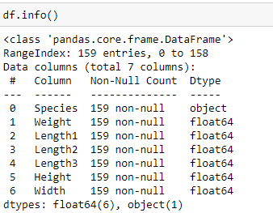
TOTAL VARIABLES INVOLVED:

Slide 4
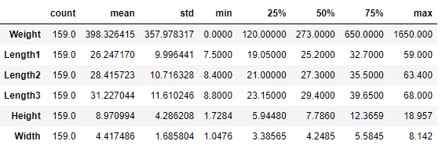
Statistical description:

Slide 5
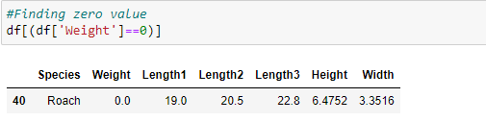
DATA CLEANING:
Since weight is usually affected by length, we'll replace the zero value with the closest Roach's length.

Slide 6
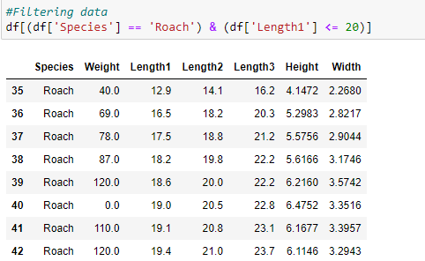
DATA CLEANING:
Filtering the data :

Slide 7
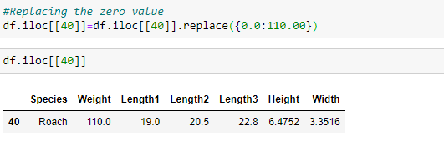
DATA CLEANING:
Replacing the zero value :

Slide 8
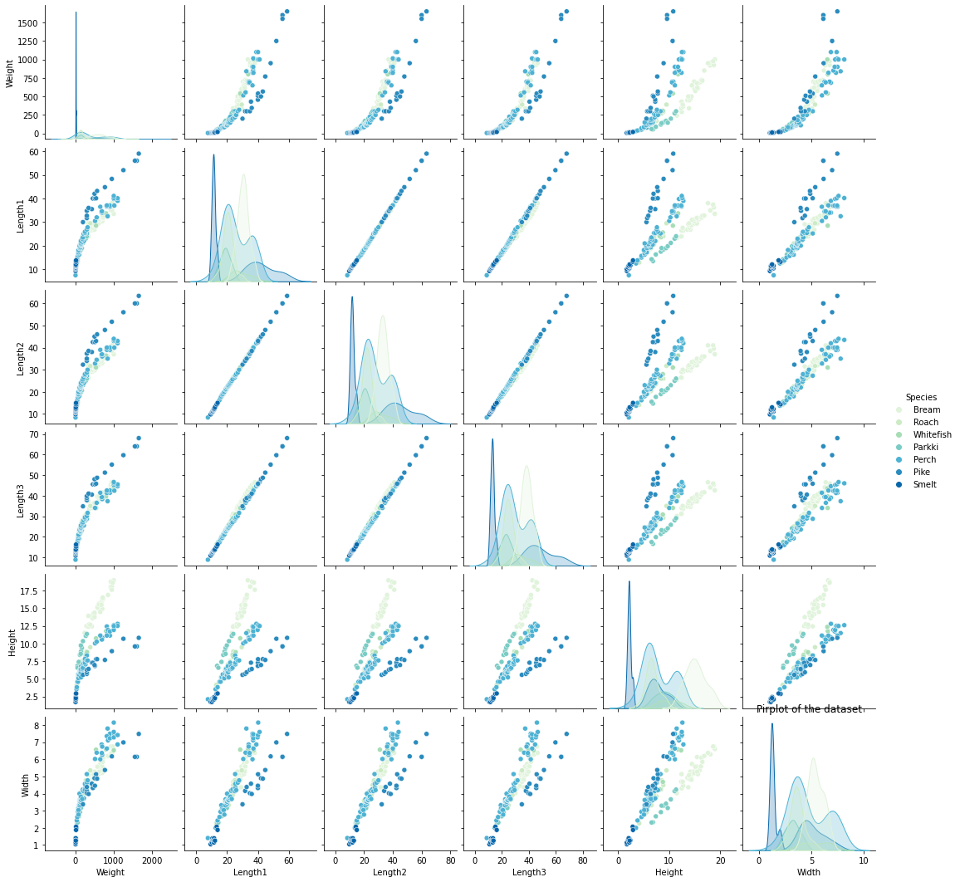
PAIRPLOT:
A pairplot plot a pairwise relationships in a dataset. The pairplot function creates a grid of Axes such that each variable in data will by shared in the y-axis across a single row and in the x-axis across a single column. That creates plots as shown below.

Slide 9
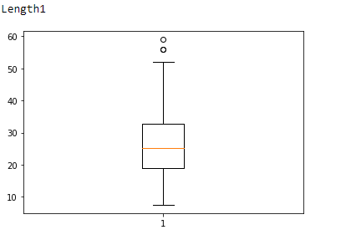
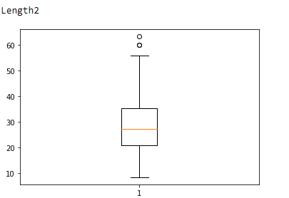
BOXPLOT TO VISUALISE OUTLIERS:

Slide 10
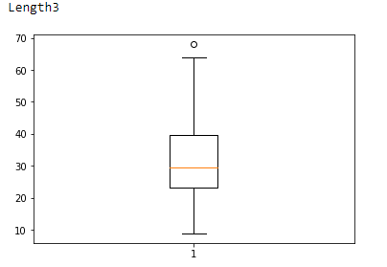
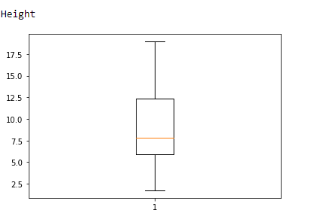
BOXPLOT TO VISUALISE OUTLIERS:

Slide 11
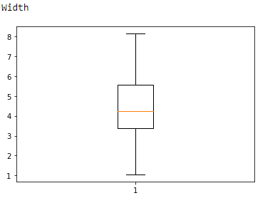
BOXPLOT TO VISUALISE OUTLIERS:

Slide 12
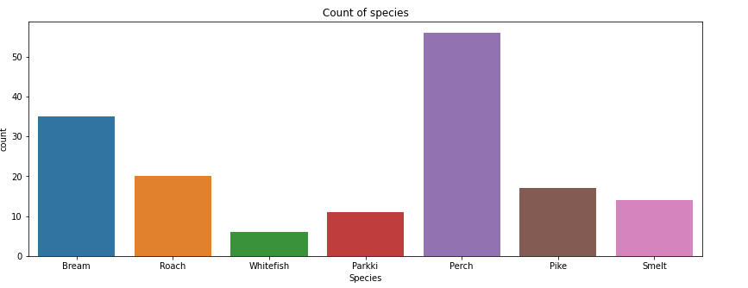
DATA VISUALIZATION :
Species and Weight :

Slide 13
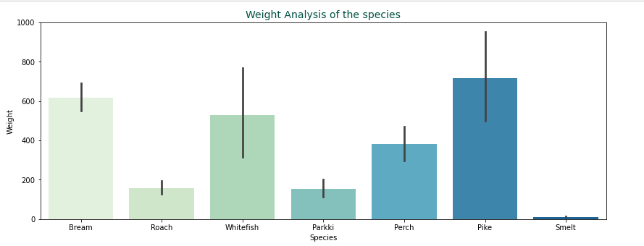
DATA VISUALIZATION :
The top 3 species with a heavier average weight are Pike, Bream, and Whitefish.

Slide 14
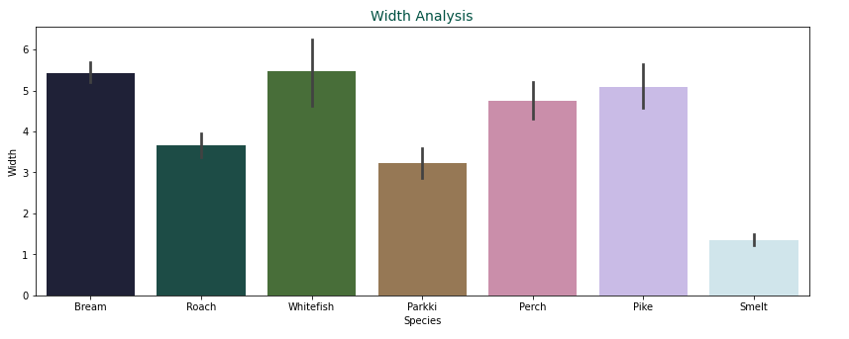
DATA VISUALIZATION :
Species and Width :
From the average width of all the fish, we can see that Whitefish and Bream is relatively wide.

Slide 15
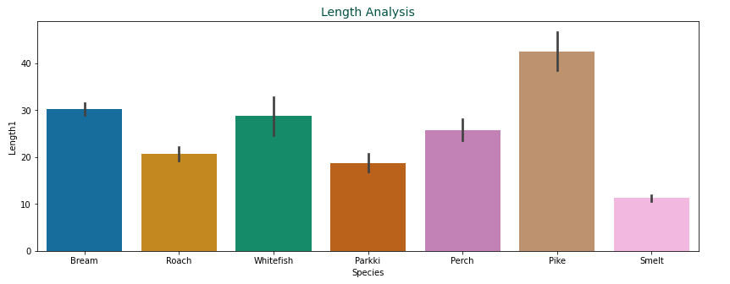
DATA VISUALIZATION :
Species and Length1 :
From the average length of all the fish, we can see that again Pike, Bream, and Whitefish is in the top 3 which means they are relatively long.

Slide 16
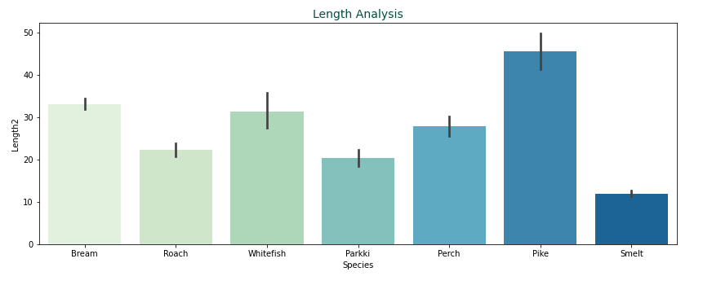
DATA VISUALIZATION :
Species and Length2:

Slide 17
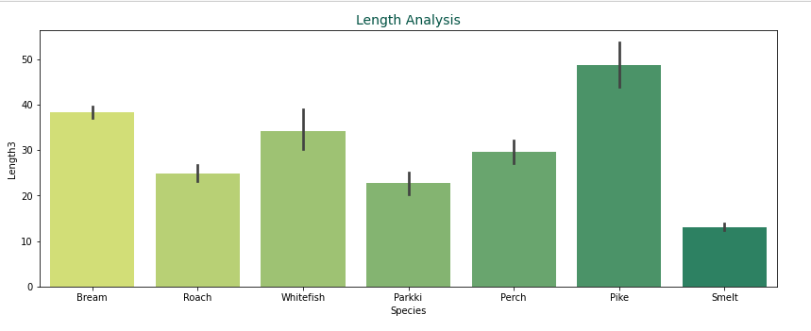
DATA VISUALIZATION :
Species and Length3 :

Slide 18
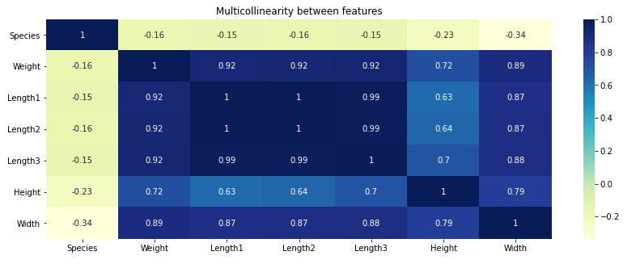
MULTICOLLINEARITY:

Slide 19
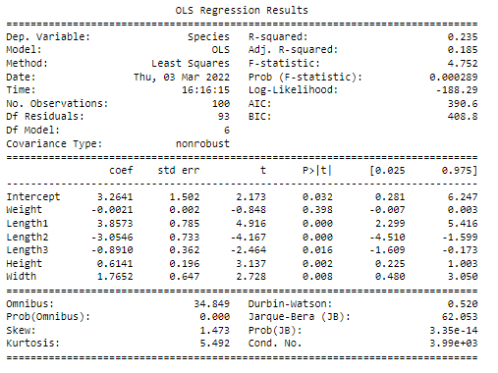
MODEL BUILDING:
OLS METHOD
MODEL 1

Slide 20
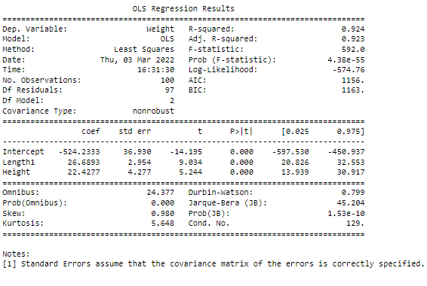
MODEL BUILDING:
OLS METHOD
MODEL 2

Slide 21

MODEL BUILDING:
SGD METHOD

Slide 22
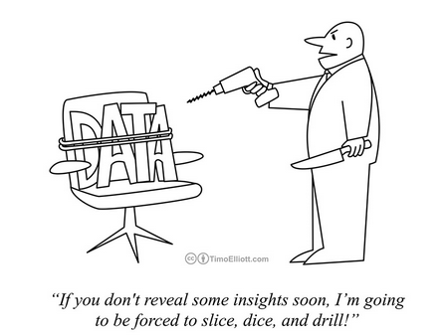
THANK YOU FOR VIEWING MY WORK!

